Slide 1
Eye Tracking

Slide 2
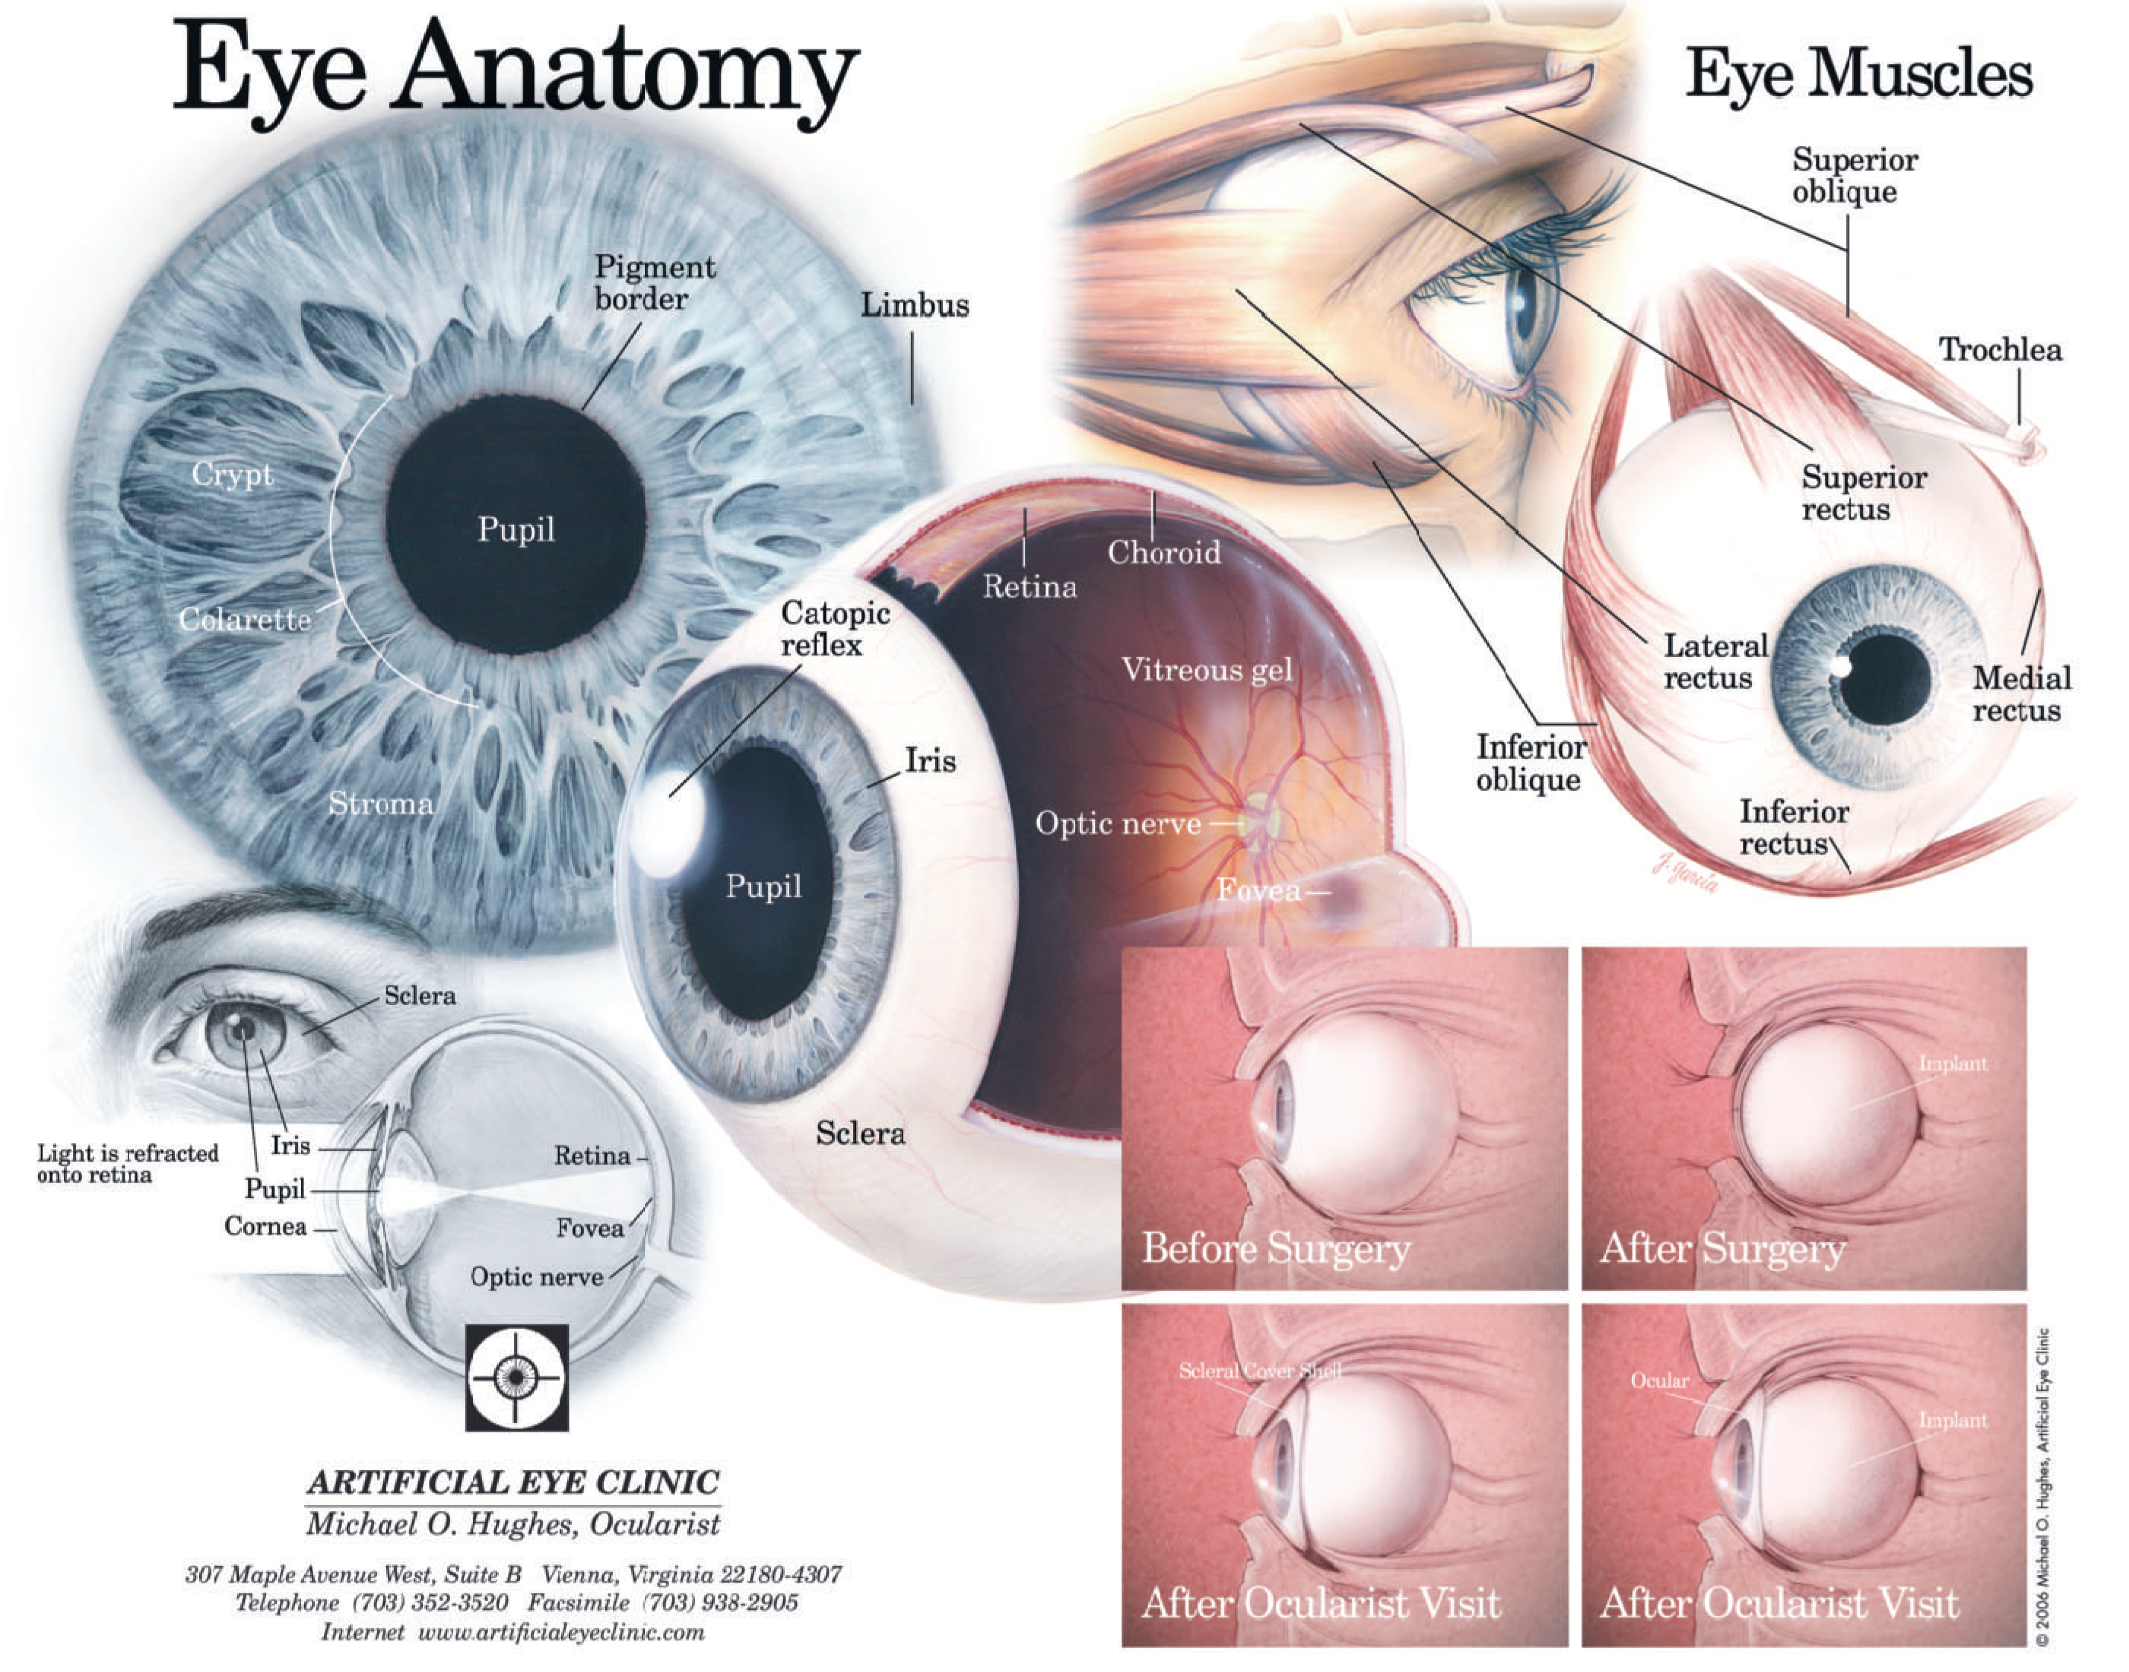
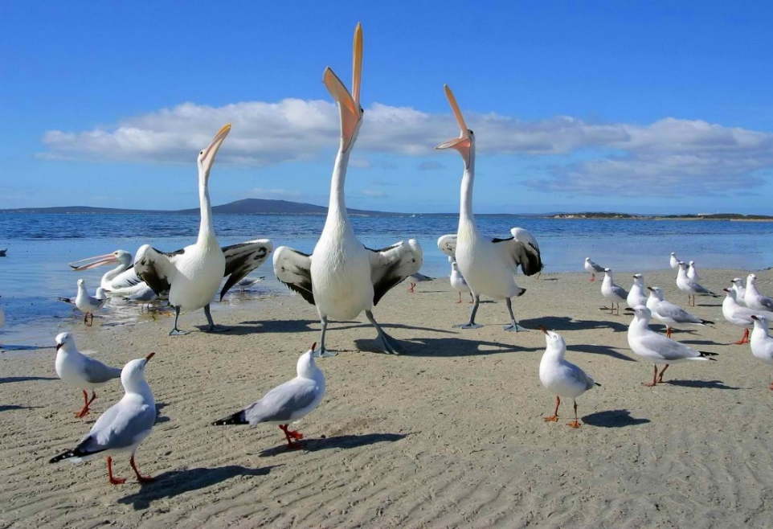

Slide 3
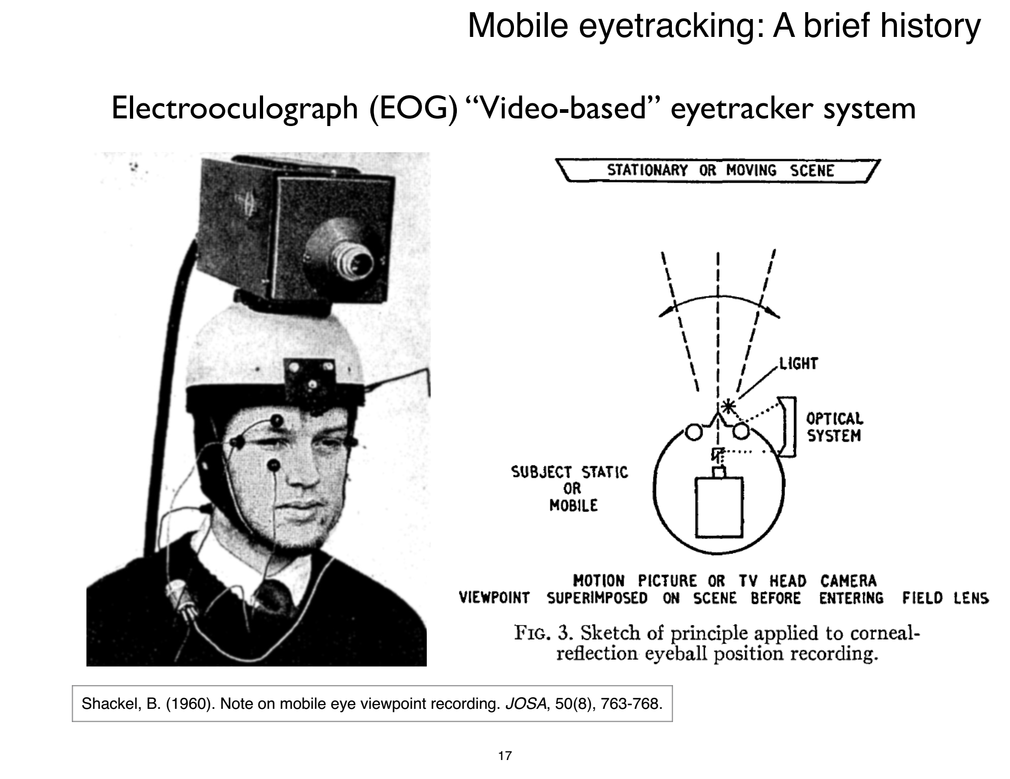

Slide 4
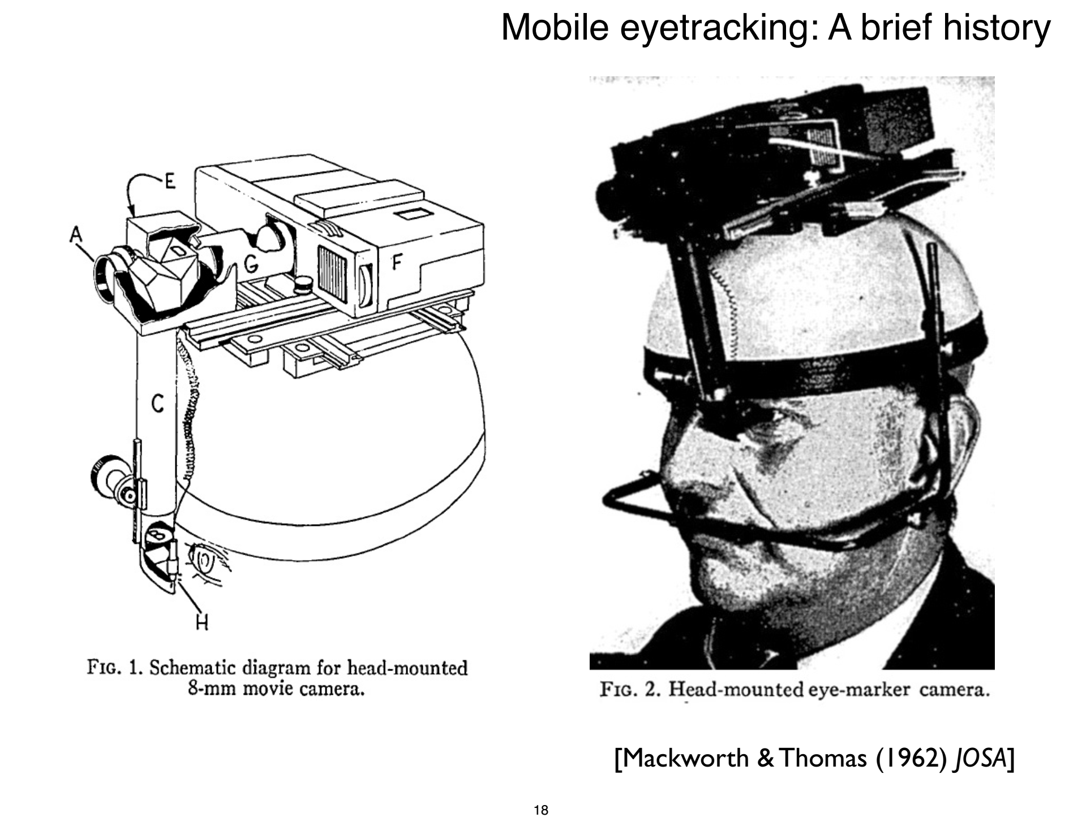

Slide 5
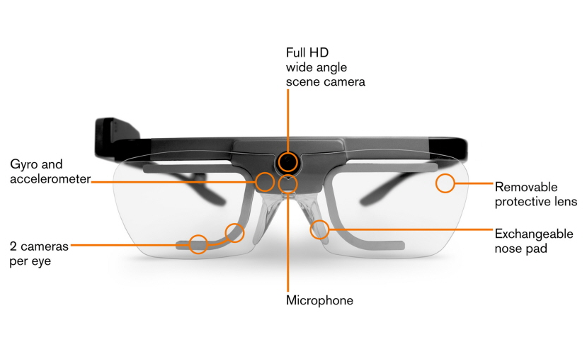

Slide 6
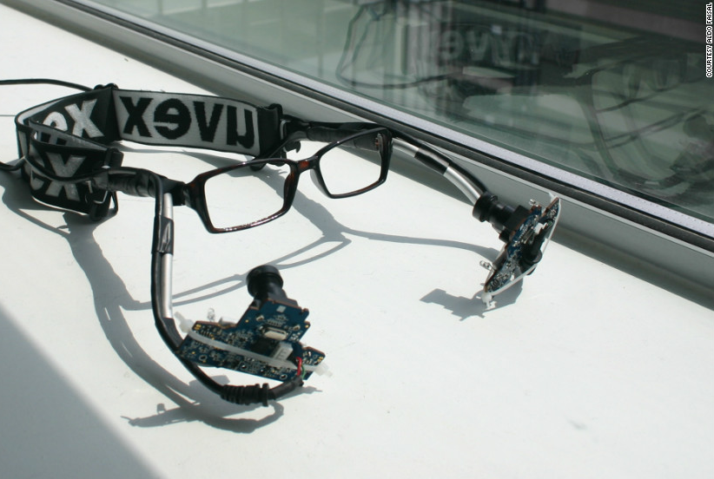

Slide 7
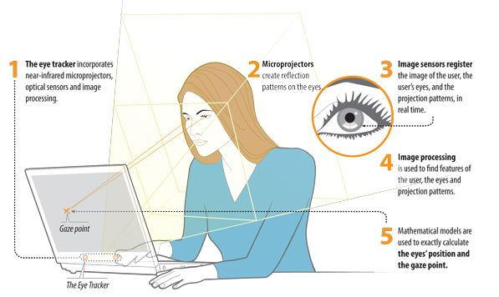

Slide 8
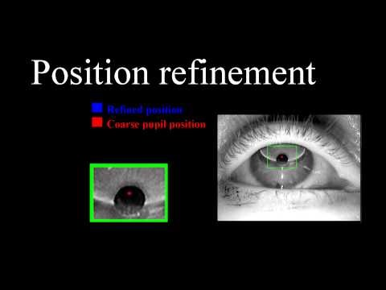

Slide 9
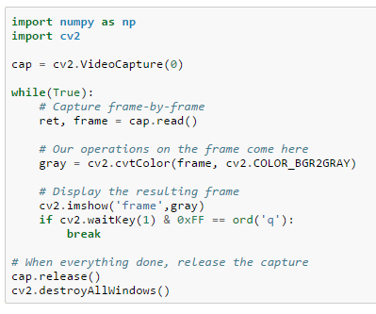
Step1. Capture Video from Camera/s

Slide 10
Image preprocessing
Time stamp
Flip
Crop
Size
Down scale
Area of interest
Distortion

Slide 11
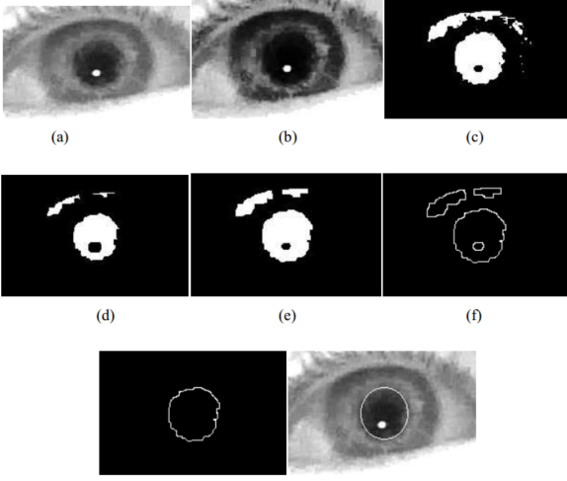
Step2. Pupil/s detection
A) The contrast between the pupil and the rest of the eye
B) Image normalization/ histogram equalization to reduce the influence of lighting conditions
C) A simple threshold function: the image is converted to a binary image
D,E) Noise reduction (e.g. dilate and erode conversions)
F,G) Edges surround the white regions in the binary image (known pupil size)
H) Apply a least squares ellipse fitting algorithm to find the center of pupil

Slide 12
Remote vs. head mounted

Slide 13
Assignment 1
Read:
Guestrin, Elias Daniel, and Moshe Eizenman. "General theory of remote gaze estimation using the pupil center and corneal reflections." IEEE Transactions on biomedical engineering 53.6 (2006): 1124-1133.
Hansen, Dan Witzner, and Qiang Ji. "In the eye of the beholder: A survey of models for eyes and gaze." IEEE transactions on pattern analysis and machine intelligence 32.3 (2010): 478-500.
Investigate:
CCD vs CMOS sensor
Global vs rolling shutter
Color vs monochrome vs NIR cameras
IR LED eye safety measures

Slide 14
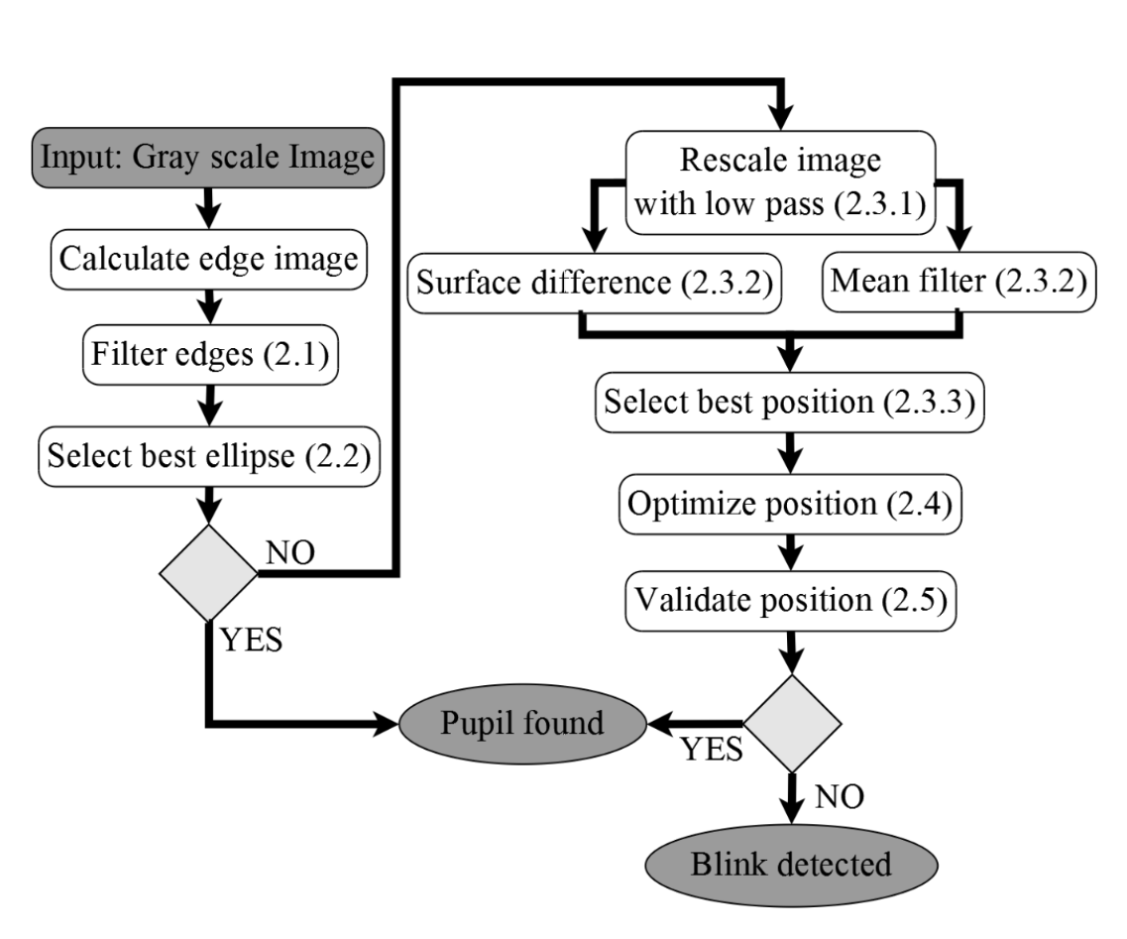
Assignment 2
EyeRecToo
http://www.ti.uni-tuebingen.de/EyeRecToo.1907.0.html
https://www.youtube.com/watch?v=vbrfjpfYkvg
https://atreus.informatik.uni-tuebingen.de/santini/EyeRecToo
Fuhl, Wolfgang, et al. "Else: Ellipse selection for robust pupil detection in real-world environments." Proceedings of the Ninth Biennial ACM Symposium on Eye Tracking Research & Applications. ACM, 2016.

Slide 15
Topics
1- Eye streamer (online real time eye tracking) (2-3)
Raspberry PI
Peer to peer station or Server
3D printing and optical design
2- High-speed eye tracking with FPGA (2)
Xilinx
Image processing unit
3- Webcam-based eye tracking (1-2)
Laptop
Face detection
Offline improvement
4- Mobile-based eye tracker (1-2)
Andriod or IOS
Face detection
Streamer

